Slide 1
CROWDSTRIKE Presents
CrowdStrike India Hackathon
[Traffic Schedule per City per Airline]

Slide 2

We have developed a Algorithm that predict traffic on each city per Airline. We develop this alogrithm in Python language ,used dictionary ,set ,file operations in python.
*Run python code in cmd and give correct file path , then it will generate solution with name predicted_traffic.csv file*

Slide 3
The scheduling problem (Approach)

Slide 4
The scheduling problem (Sourcecode)
**Performing 2nd task -> Source code file: minimize_hop.py**

Slide 5
The optimal itinerary problem(Approach)
we are generating this "minimum_hop.csv" file using external '.json' file source via link :-
1. We are generating "dataset.csv" using above '.json' file in nodejs.
2. We are then using this "dataset.csv" file to generate our solution file "minimum_hop.csv".

Slide 6
Github link if source code not uploaded
The optimal itinerary problem (Sourcecode)

Slide 7
We are using airline based dataset to finding the aggregate traffic covering through a airline to india . We are calculating the individual weightage in percentage to find the traffic through a airline i.e 33.13 by Air India.
Then by using citywise based dataset and fetching traffic in individual city quarterly so by obtaining traffic through each airline by their percentage per city.
As getting this data we are generating a csv file with all the data in it so that the DA and user does not have to handle any kind of problem.
E.G. – percentage traffic for Air India 33.13
then total taffic through Air India in delhi city 522861.
The demand dare problem(Approach)

Slide 8
Source code has been submitted along with the pptx file that is zipped and uploaded.
Source code file name -> traffic_prediction.py
Generated CSV file -> predicted_traffic.csv
The demand rate problem (Sourcecode)

Slide 9
Technical architecture/ POC

Slide 10
Brief explanation of the technology stack that was used
Technology/Tool Stack
Used python and Laravel technology

Slide 11
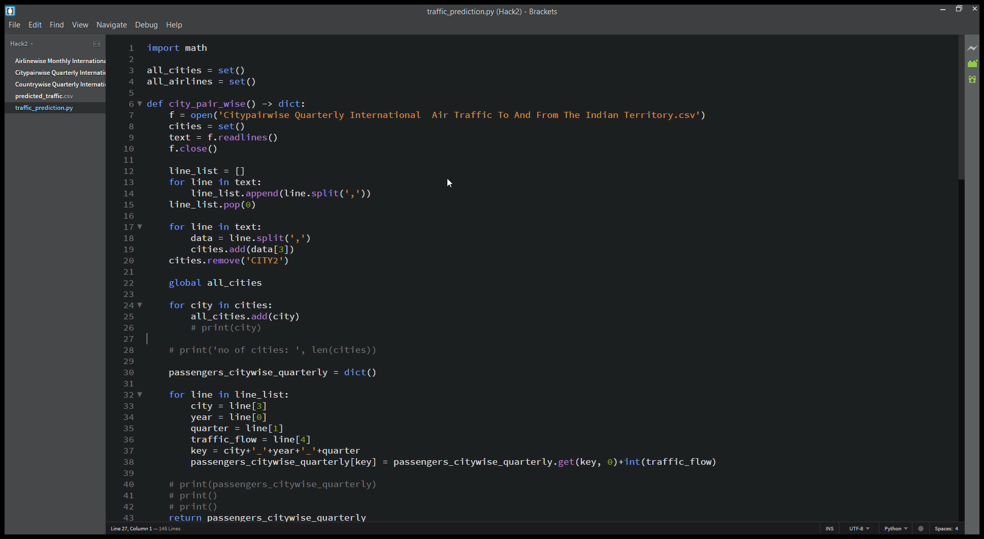
Prototype Demo(Video/Screenshots)

Slide 12
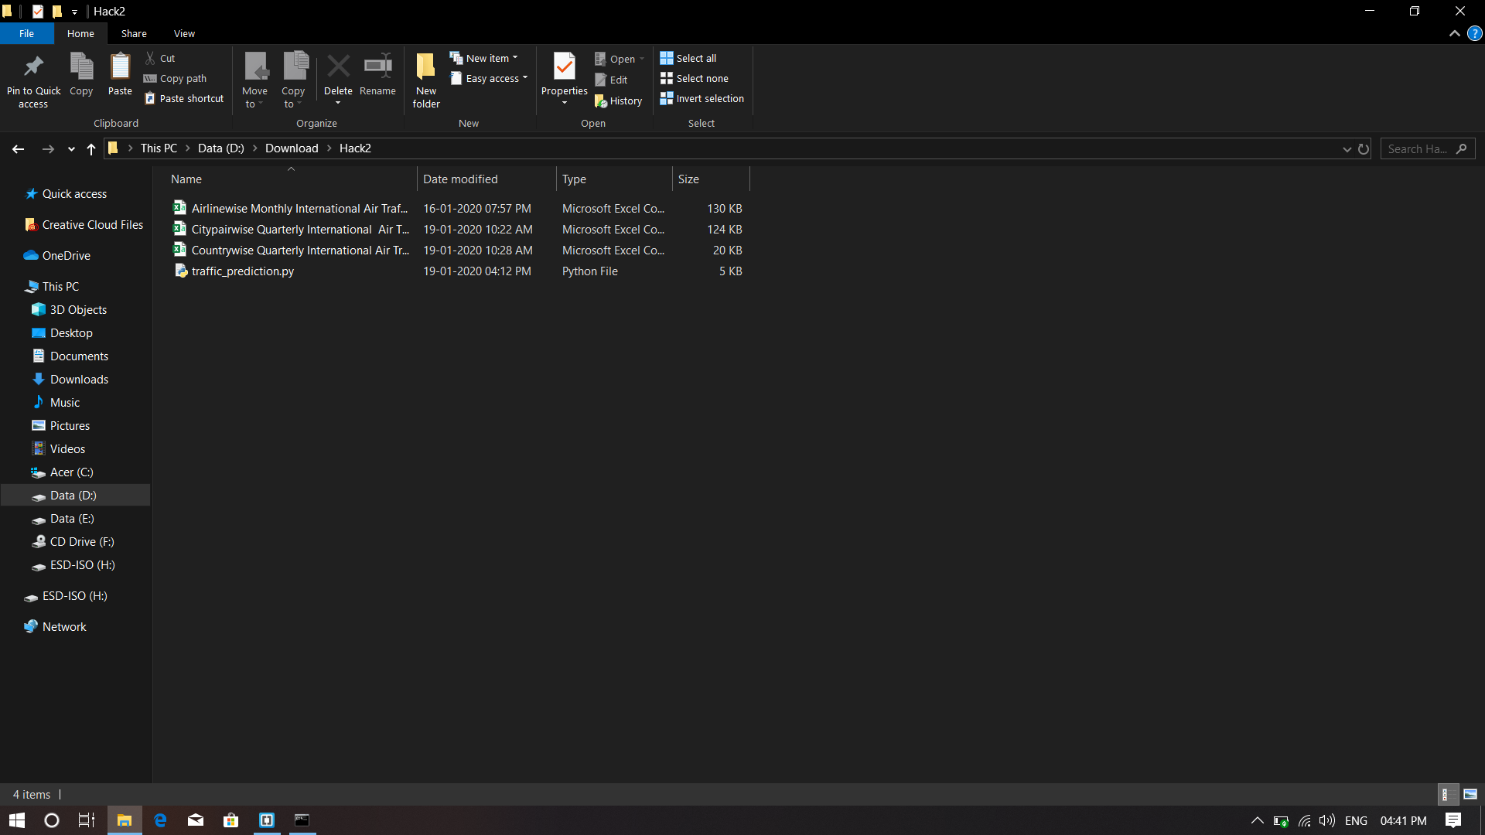
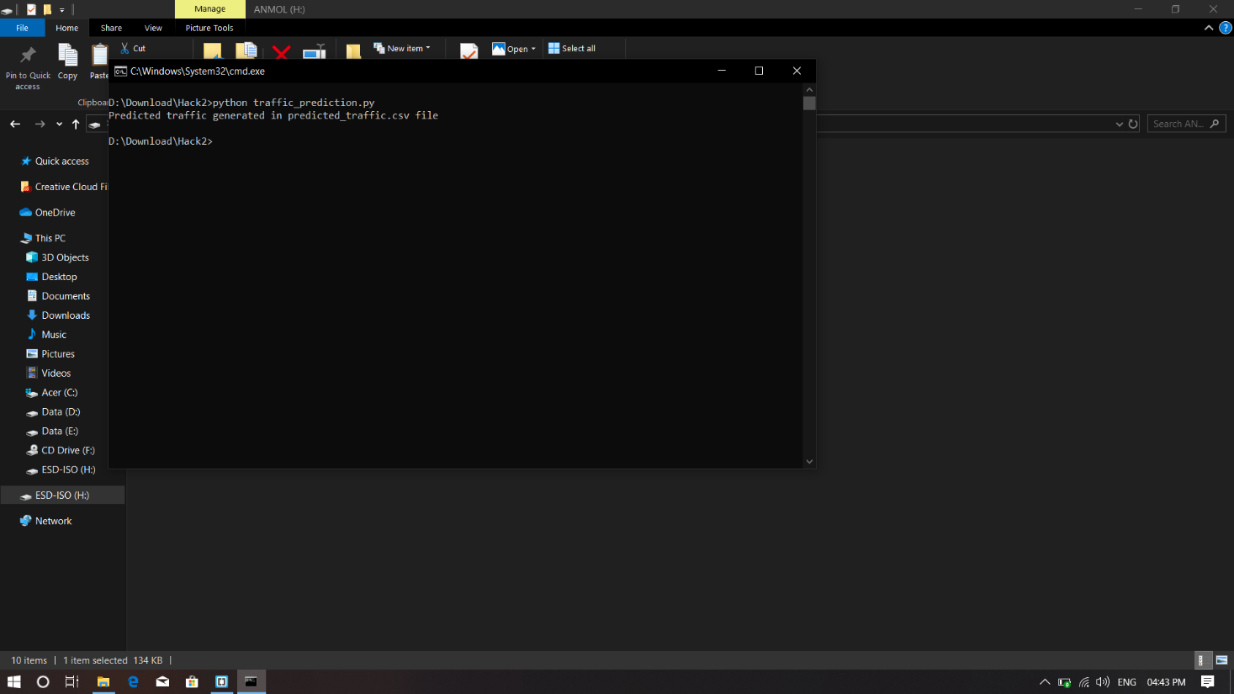
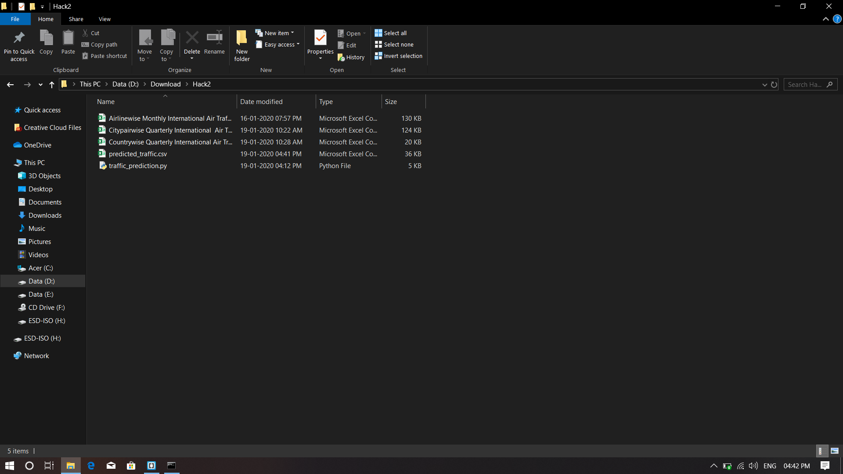
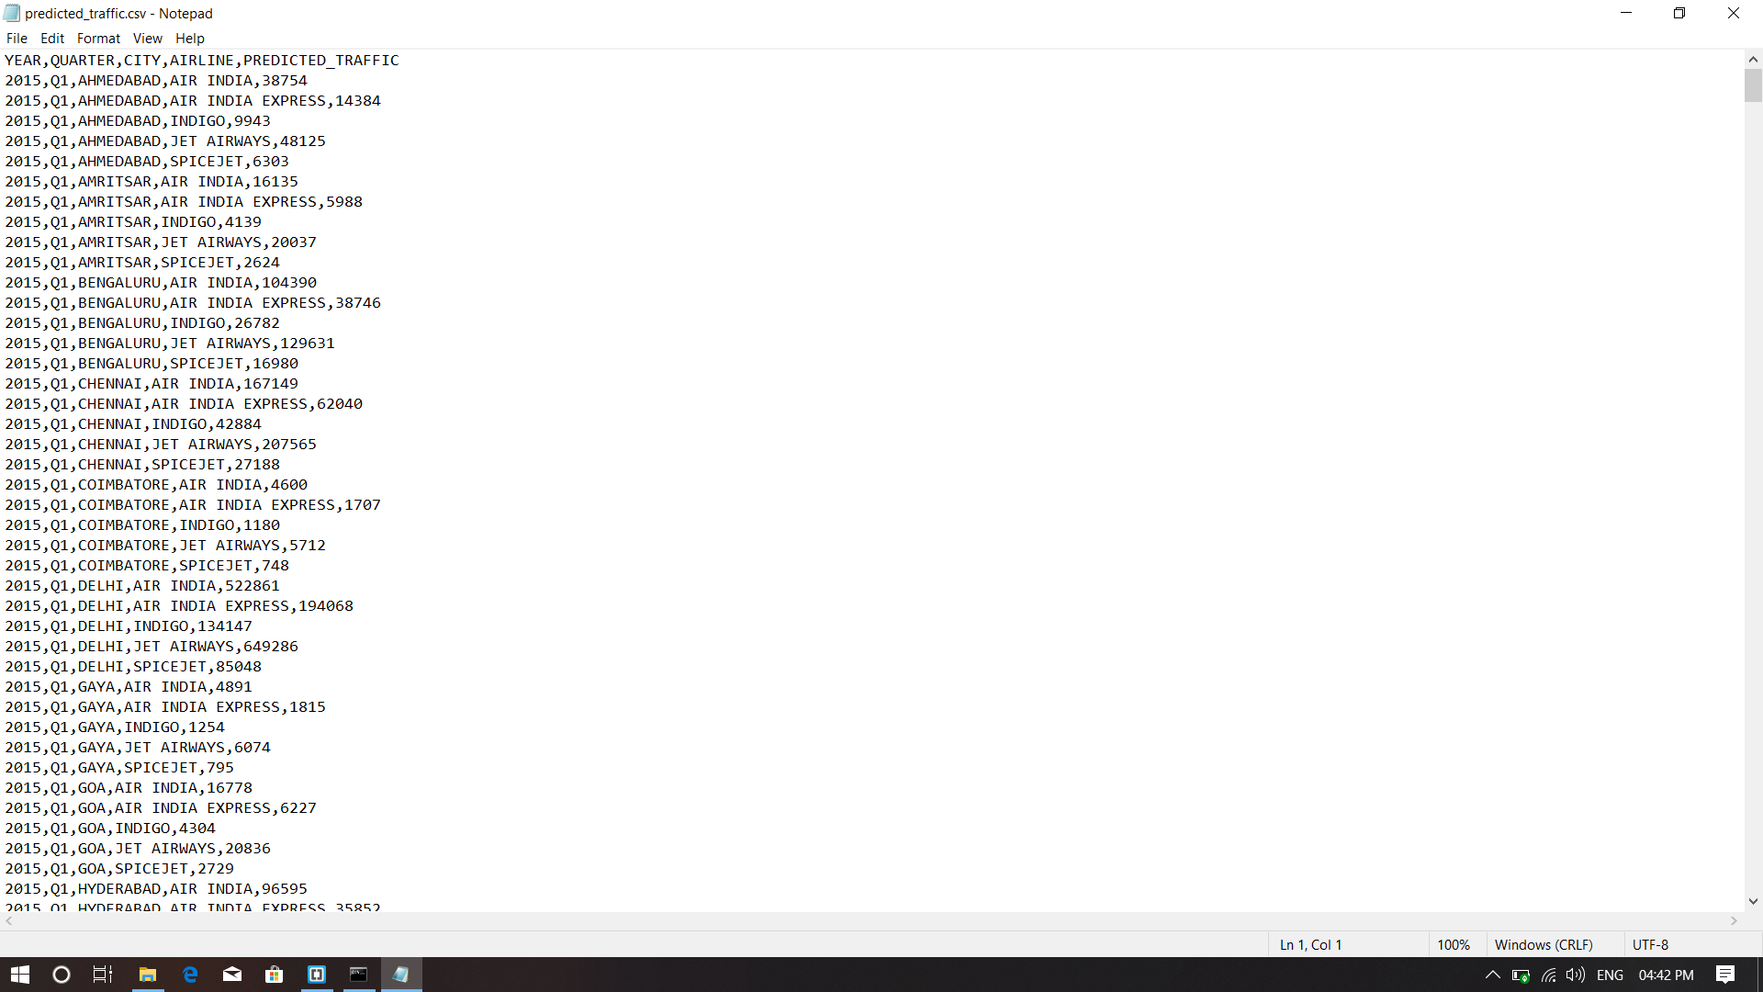

Slide 13
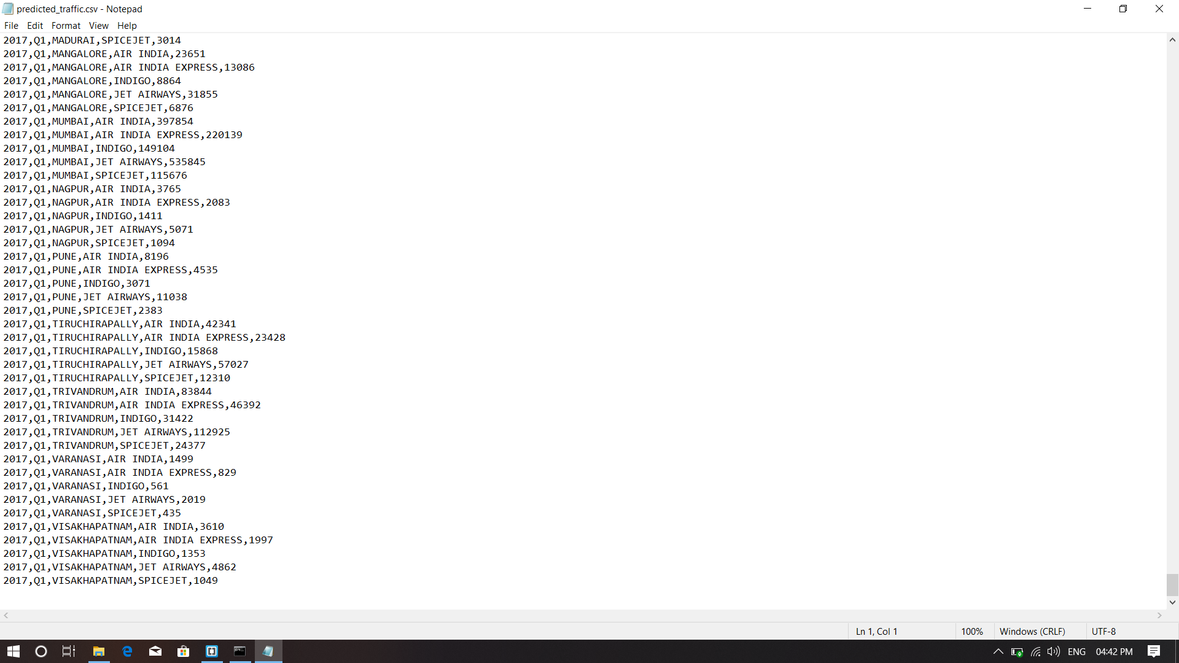

Slide 14
Possible Improvement
-> yes we have ideas for improvement in out project for airtraffic control.

Slide 15
Any technological challenge that you faced in building the application and how you solved them
Challenges faced

Slide 16


